Slide 1
Learning Objective
I will be able to differentiate trigonometric functions
Success Criteria
At the end of the lesson, I will be able to:
Establish the formulae for trigonometric functions by graphical treatment, numerical estimations of limits and informal proofs based on geometric constructions

Slide 2
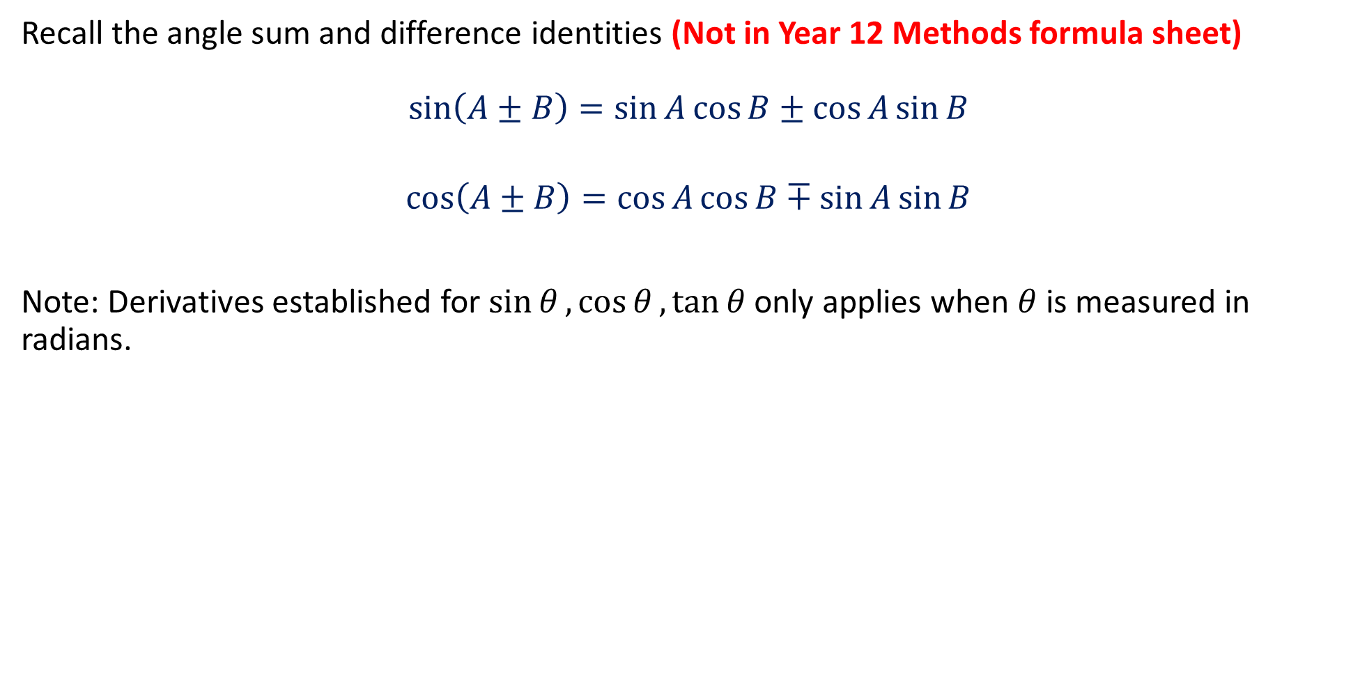
Activating prior knowledge
Recall the angle sum and difference identities (Not in Year 12 Methods formula sheet)
$$\sin\left(A±B\right)=\sin{A}\cos{B}±\cos{A}\sin{B}$$
$$\cos\left(A±B\right)=\cos{A}\cos{B}∓\sin{A}\sin{B}$$
Note: Derivatives established for $\sin{θ},\cos{θ},\tan{θ}$ only applies when $θ$ is measured in radians.

Slide 3
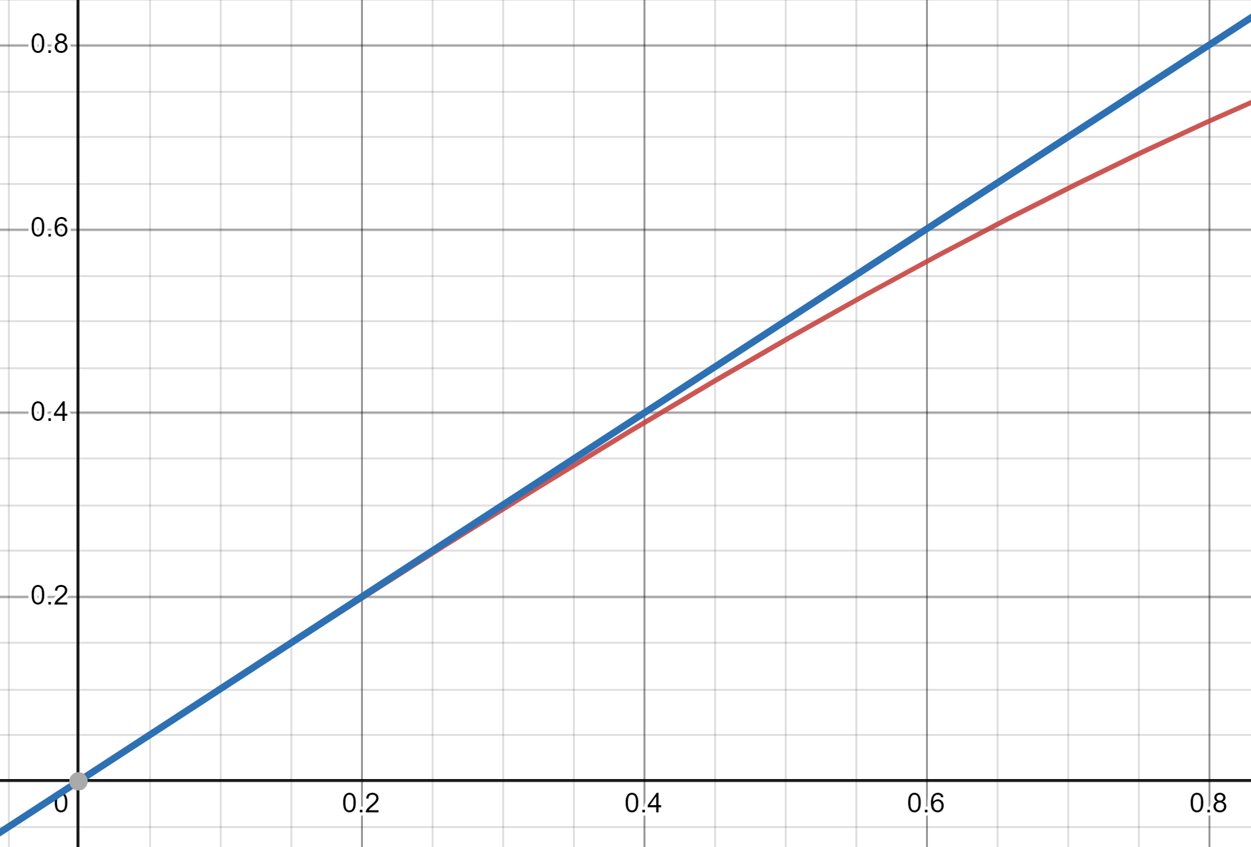
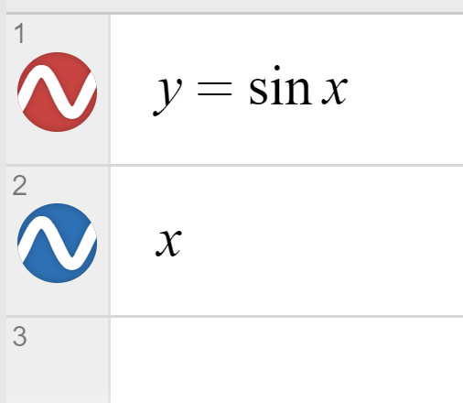
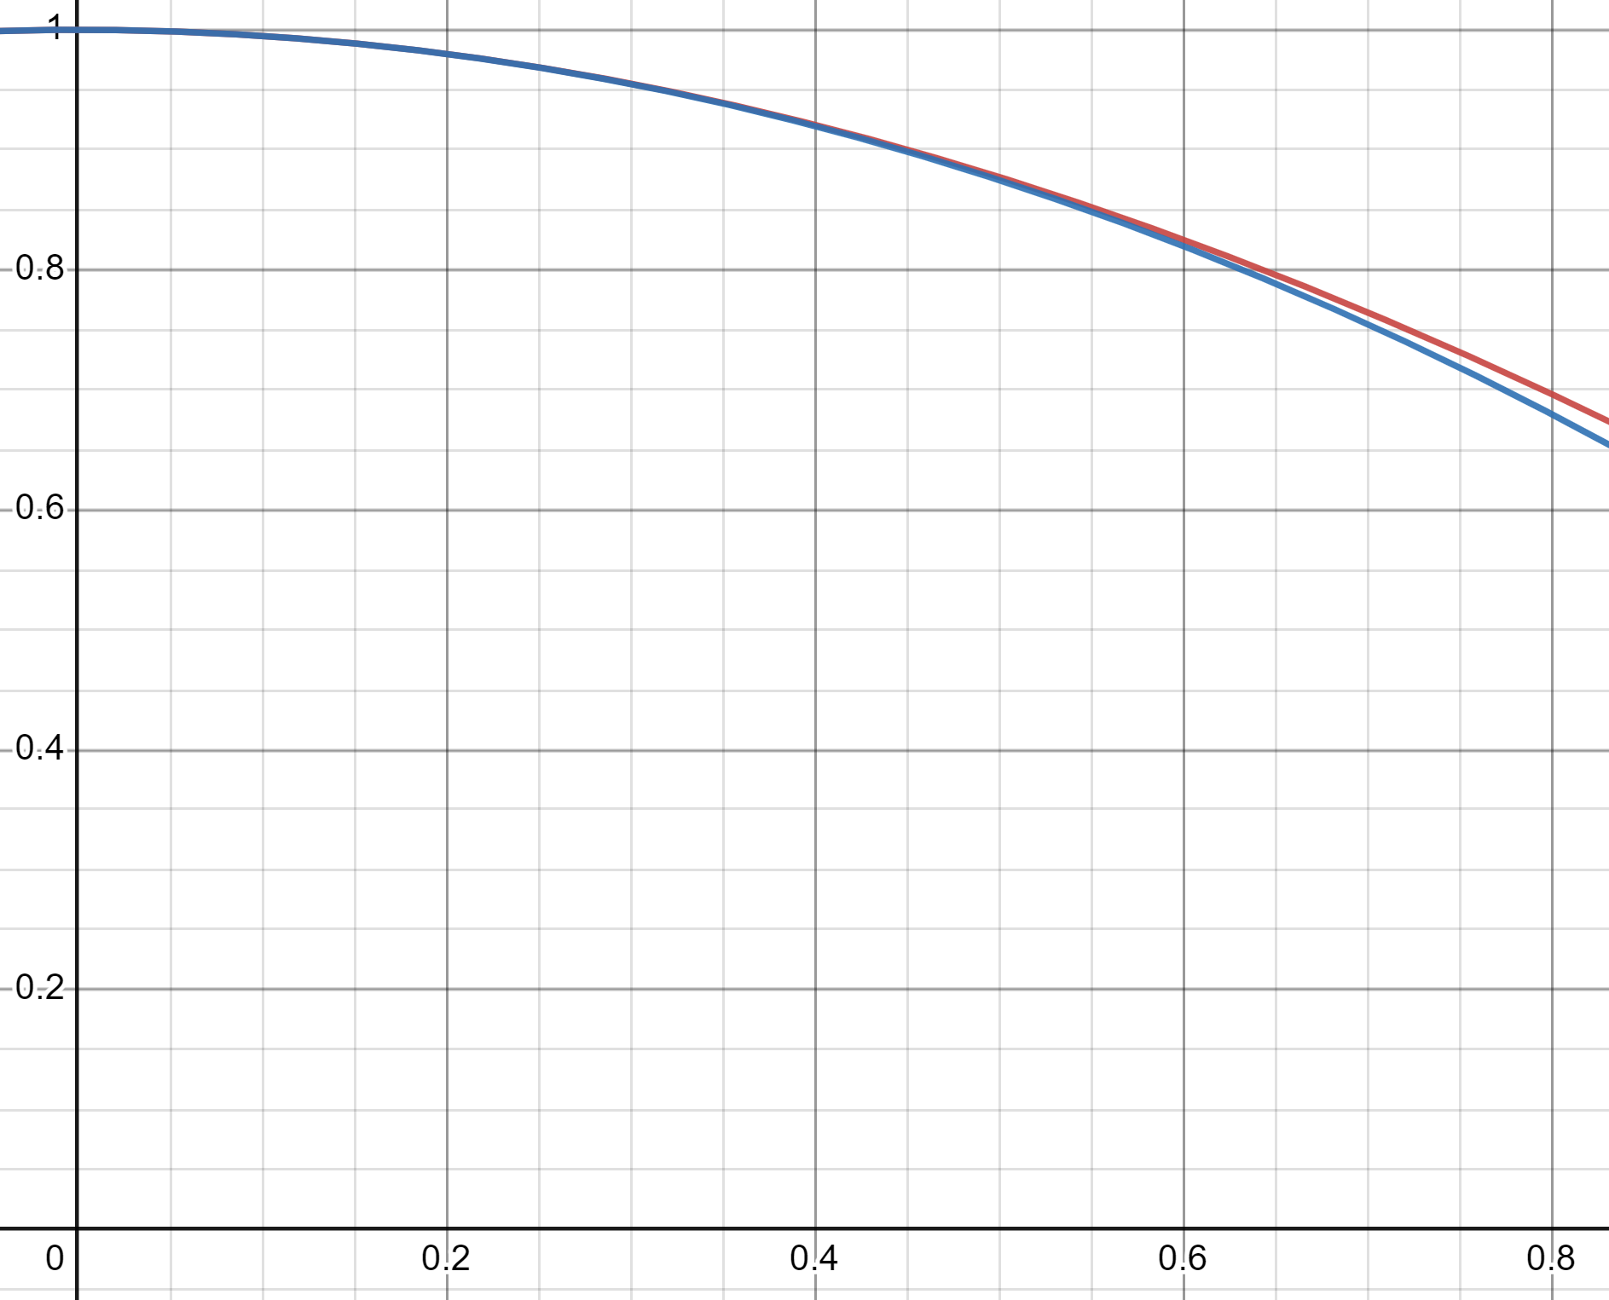
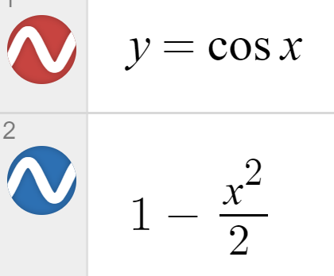


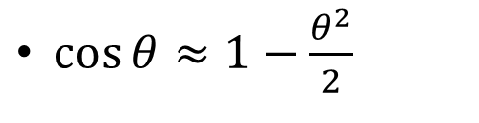
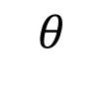
Concept Development
Small-Angle approximation- for estimates of basic trigonometric functions.
$\cos{θ}≈1−\frac{θ^{2}}{2}$
$$θ$$
$\tan{θ}≈$?
$\sin{θ}≈θ$

Slide 4
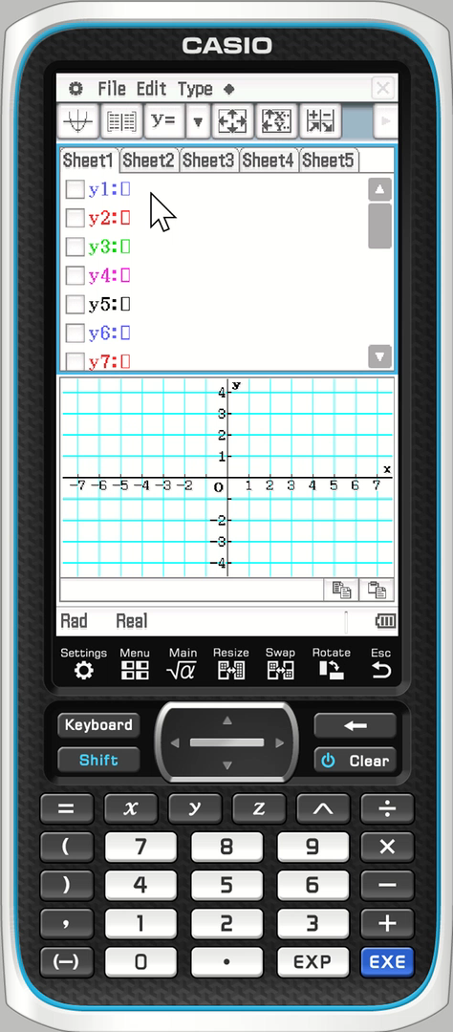
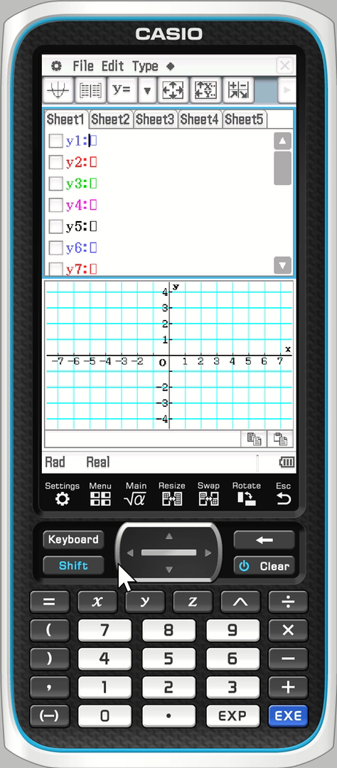


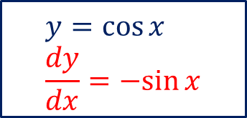
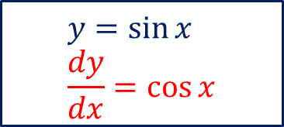
ClassPad Activity
Plot $y=\sin{x}$ and $\frac{dy}{dx}$ in your ClassPad. What do you observe?
Plot $y=\cos{x}$ and $\frac{dy}{dx}$ in your ClassPad. What do you observe?
$$y=\sin{x} \\ \frac{dy}{dx}=\cos{x}$$
$$y=\cos{x} \\ \frac{dy}{dx}=−sin{x}$$

Slide 5



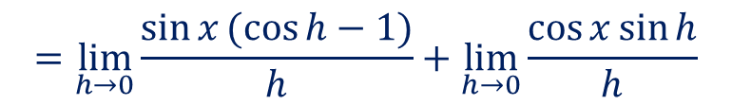



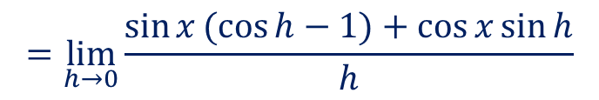

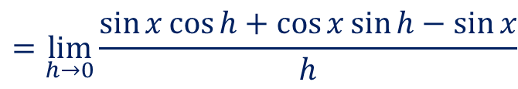


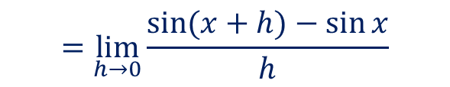
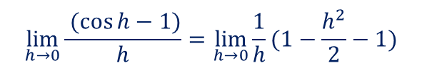

Derivative of sinx (Optional)
Consider $y{=\sin{x}}$ using first principles, prove that $\frac{dy}{dx}{=\cos{x}}$
$$\lim_{h→0}{\frac{f\left(x+h\right)−f(x)}{h}}$$
$$=\lim_{h→0}{\frac{sin⁡(x+h)−\sin{x}}{h}}$$
$$=\lim_{h→0}{\frac{\sin{x}\cos{h}+\cos{x}\sin{h}−\sin{x}}{h}}$$
Recall $as θ→0, cos{θ}≈1−\frac{θ^{2}}{2}$
$$\lim_{h→0}{\frac{ (\cos{h−1)}}{h}}=\lim_{h→0}{\frac{1}{h}(1−\frac{h^{2}}{2}−1)}$$
$$=\lim_{h→0}{\frac{\sin{x}(\cos{h−1)}+\cos{x}\sin{h}}{h}}$$
$$=\lim_{h→0}{\frac{1}{h}(−\frac{h^{2}}{2})}$$
$$=\lim_{h→0}{\frac{\sin{x}(\cos{h−1)}}{h}}+\lim_{h→0}{\frac{\cos{x}\sin{h}}{h}}$$
$$=\lim_{h→0}{ (−\frac{h}{2})}$$
$$=0$$
$$=\sin{x×0}+\cos{x}×1$$
Recall $as θ→0, sin{θ}≈θ$
$$=\cos{x}$$
$$\lim_{h→0}{\frac{\sin{h}}{h}}=\lim_{h→0}{\frac{h}{h}}$$
$$=1$$
The same concept can be applied to differentiating $y=\cos{x}$

Slide 6
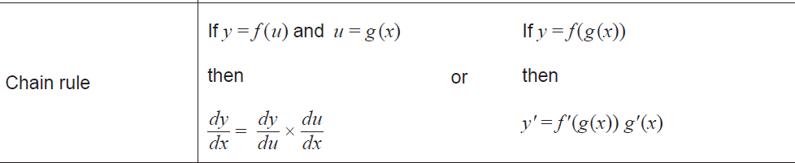





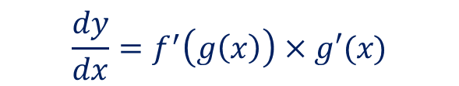

Concept Development
Consider $y{=\sin{(kx)}}$ determine $\frac{dy}{dx}{ }$using chain rule
$$f(x)=\sin{x}$$
$$g\left(x\right)=kx$$
$$f′(x)=\cos{x}$$
$$g′\left(x\right)=k$$
$$\frac{dy}{dx}=f^{′}\left(g\left(x\right)\right)×g′(x)$$
$$=\cos\left(kx\right)×k$$
$$=\operatorname{kcos}\left(kx\right)$$

Slide 7










Derivative of cos x (Optional)
Consider $y{=}cos x$ determine $\frac{dy}{dx}{ }$using the knowledge of the derivative of sin and complementary angle identity
$$\cos{x}=\sin\left(\frac{π}{2}−x\right),\sin{x}=\cos\left(\frac{π}{2}−x\right)$$
(Not in Year 12 Methods formula sheet)
$$y=\cos{x}=\sin\left(\frac{π}{2}−x\right)$$
Let $u=\frac{π}{2}−x$
$$∴y=\sin{u}$$
$$\frac{du}{dx}=−1$$
$$\frac{dy}{du}=\cos{u}$$
$$\frac{dy}{dx}=\frac{dy}{du}×\frac{du}{dx}$$
$$=\cos{u}×(−1)$$
$$=−\cos\left(\frac{π}{2}−x\right)$$
$$=−\sin{x}$$

Slide 8


Concept Development
Consider $y{=\tan{x}},$
$$\frac{dy}{dx}=\frac{1}{\cos^{2}{x}}$$
(this will be proved in Ex 4K)
$$=\sec^{2}{x}$$
Introducing a new function,
$$\frac{1}{\cos{θ}}=\sec{θ}$$

Slide 9
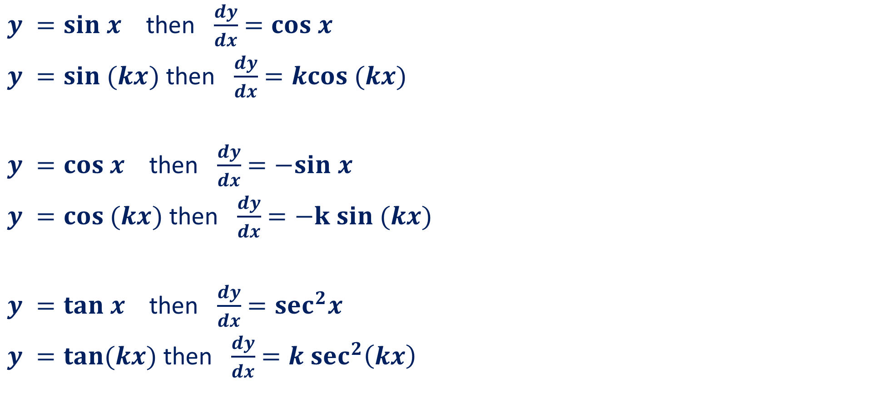
In Summary
$y =sin x$ then $\frac{dy}{dx}$ $=cos x$
$y =sin (kx)$ then $\frac{dy}{dx}$ $=kcos (kx)$
$y =cos x$ then $\frac{dy}{dx}$ $=−sin x$
$y =cos (kx)$ then $\frac{dy}{dx}$ $=−k sin (kx)$
$y =tan x$ then $\frac{dy}{dx}$ $=sec^{2}x$
$y =tan(kx)$ then $\frac{dy}{dx}$ $=k sec^{2}\left(kx\right)$

Slide 10
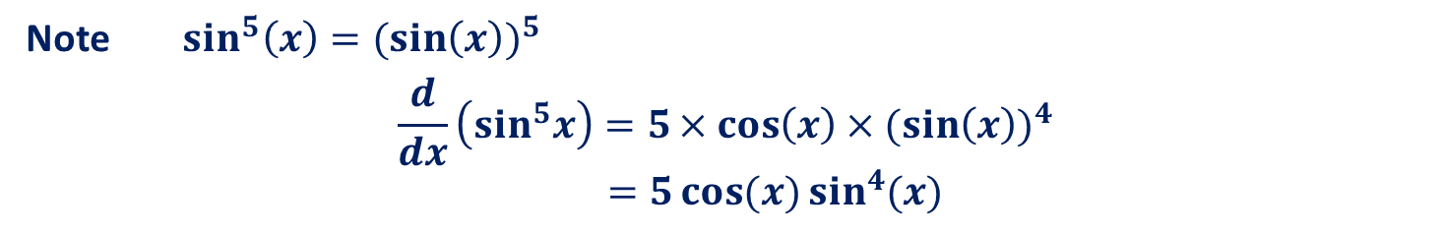
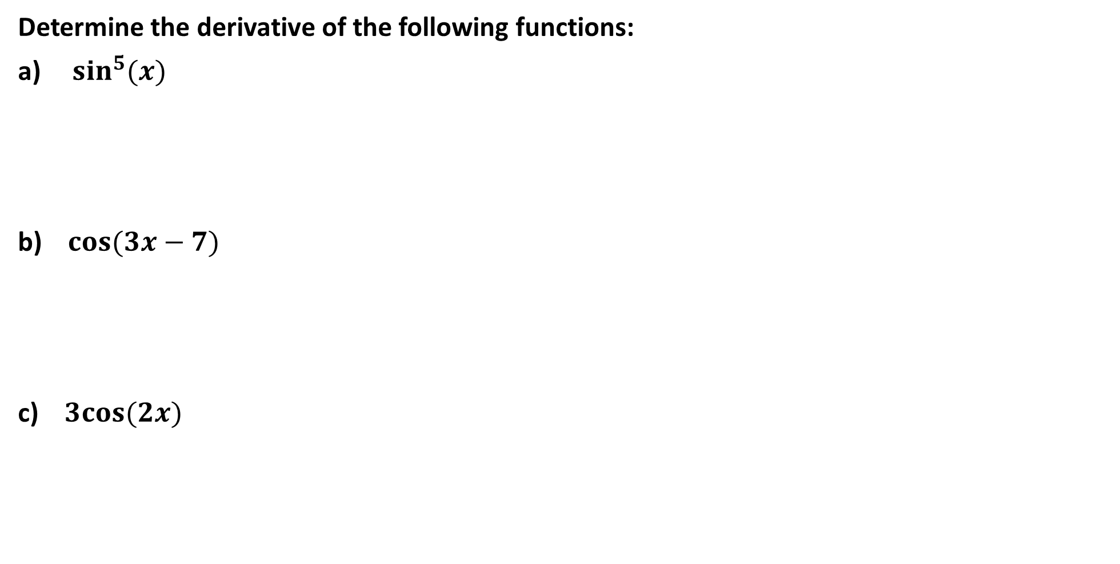


Guided Practice
Determine the derivative of the following functions:
$\sin^{5}(x)$
b) $cos(3x−7)$
c) $3cos(2x)$
Note $\sin^{5}\left(x\right)=(\sin\left(x\right))^{5}$
$$\frac{d}{dx}\left(sin^{5}x\right)=5×cos\left(x\right)×(sin\left(x\right))^{4}$$
$=5\cos{(x)sin^{4}{(x)}}$
$$\frac{d}{dx}\left(cos\left(3x−7\right)\right)=3×−sin\left(3x−7\right)$$
$=−3sin\left(3x−7\right)$
$$\frac{d}{dx}\left(3cos \left(2x\right)\right)=3×2×−sin\left(2x\right)$$
$=−6 sin\left(2x\right)$

Slide 11
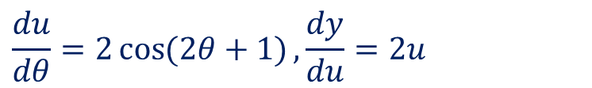
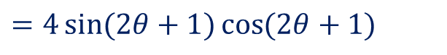

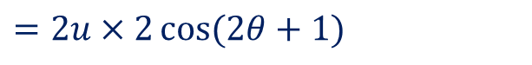
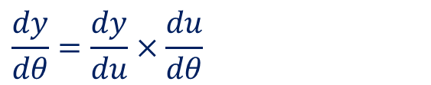

Guided Practice
Find the derivative of the following with respect to $θ$
$$y=\sin^{2}\left(2θ+1\right)$$
Let $u=\sin{(2θ+1)}, y=u^{2}$
$$\frac{du}{dθ}=2\cos{(2θ+1)}, \frac{dy}{du}=2u$$
$$\frac{dy}{dθ}=\frac{dy}{du}×\frac{du}{dθ}$$
$$=2u×2\cos{(2θ+1)}$$
$$=4\sin{(2θ+1)}\cos{(2θ+1)}$$

Slide 12
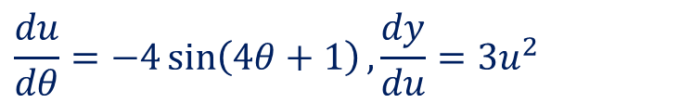
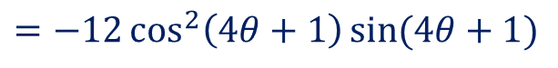

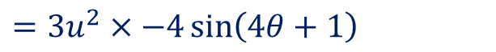

Guided Practice
Find the derivative of the following with respect to $θ$
$${y=cos}^{3}{(4θ+1)}$$
Let $u=\cos{(4θ+1)}, y=u^{3}$
$$\frac{du}{dθ}=−4\sin\left(4θ+1\right), \frac{dy}{du}=3u^{2}$$
$$\frac{dy}{dθ}=\frac{dy}{du}×\frac{du}{dθ}$$
$$=3u^{2}×−4\sin\left(4θ+1\right)$$
$$=−12\cos^{2}\left(4θ+1\right)\sin{(4θ+1)}$$

Slide 13
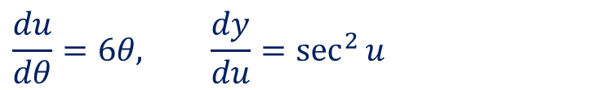
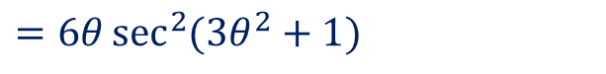

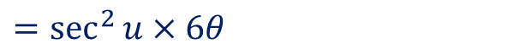

Guided Practice
Find the derivative of the following with respect to $θ$
$$y=\tan\left(3θ^{2}+1\right)$$
Let $u=3θ^{2}+1, y=\tan{u}$
$$\frac{du}{dθ}=6θ, \frac{dy}{du}=\sec^{2}{u}$$
$$\frac{dy}{dθ}=\frac{dy}{du}×\frac{du}{dθ}$$
$$=\sec^{2}{u}×6θ$$
$$=6θ\sec^{2}{(3θ^{2}+1)}$$

Slide 14

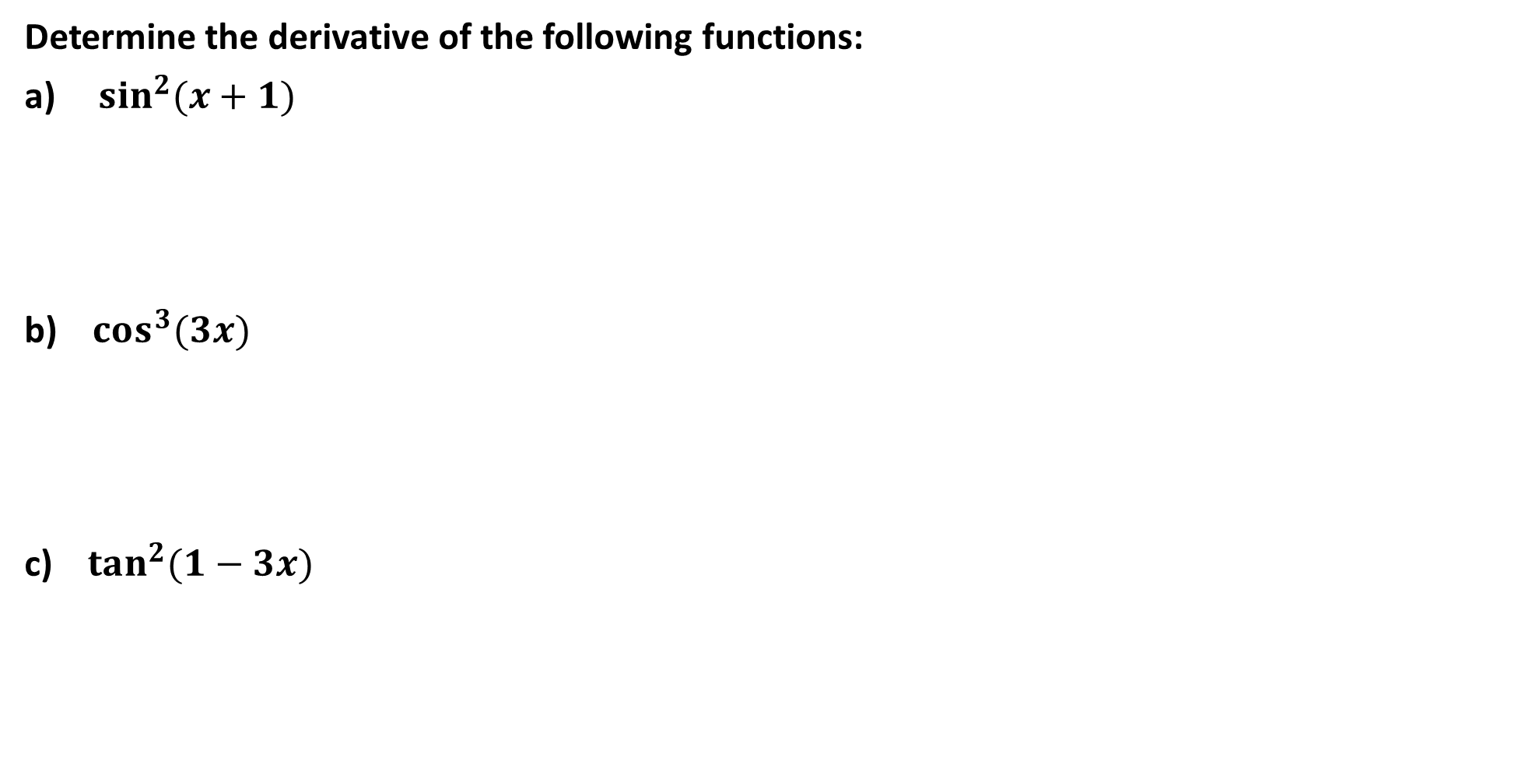
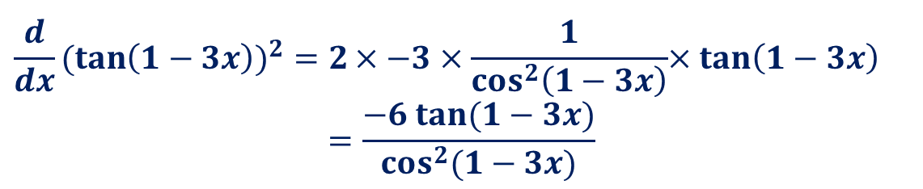
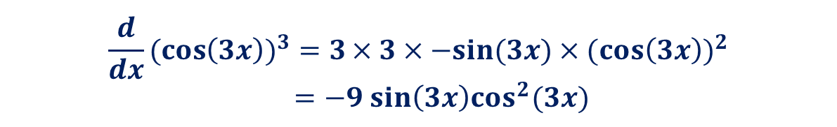
Guided Practice
Determine the derivative of the following functions:
$\sin^{2}(x+1)$
b) $cos^{3}(3x)$
c) $tan^{2}(1−3x)$
Note $\sin^{2}\left(x+1\right)=(\sin\left(x+1\right))^{2}$
$$\frac{d}{dx}(\sin\left(x+1\right))^{2}=2×cos{(x+1)×(\sin{(x+1))}}$$ $=2\cos{(x+1)(\sin{(x+1))}}$
$$\frac{d}{dx}(\cos\left(3x\right))^{3}=3×3×−sin{(3x)×(cos\left(3x\right))^{2}}$$
$=−9 sin\left(3x\right)cos^{2}(3x)$
$$\frac{d}{dx}(\tan\left(1−3x\right))^{2}=2×−3×\frac{1}{cos^{2}\left(1−3x\right)}{×tan\left(1−3x\right)}$$
$$=\frac{−6 tan(1−3x)}{cos^{2}(1−3x)}$$

Slide 15

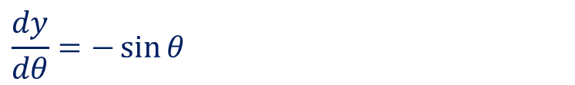

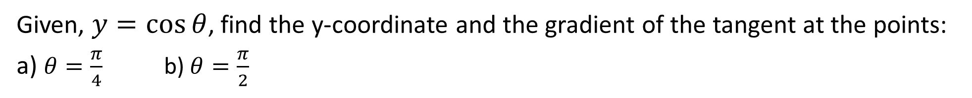




Guided Practice
Given, $y=\cos{θ}$, find the y-coordinate and the gradient of the tangent at the points:
a) $θ=\frac{π}{4}$ b) $θ=\frac{π}{2}$
Finding the y-coordinate:
Substi. $θ=\frac{π}{4}$ into $y$, $y=\cos\left(\frac{π}{4}\right)=\frac{\sqrt{2}}{2}$
Finding the y-coordinate:
Substi. $θ=\frac{π}{4}$ into $y$, $y=\cos\left(\frac{π}{2}\right)=0$
$$\frac{dy}{dθ}=−\sin{θ}$$
$$\text{Substi}\text{. }θ=\frac{π}{2}\text{into}\frac{dy}{dθ}, \frac{dy}{dθ}=−\sin\left(\frac{π}{2}\right)=−1$$
$$\text{Substi}\text{. }θ=\frac{π}{4}\text{into}\frac{dy}{dθ}, \frac{dy}{dθ}=−\sin\left(\frac{π}{4}\right)=−\frac{\sqrt{2}}{2}$$
Gradient at $\left(\frac{π}{2}, 0\right)$ is $−1$
Gradient at $\left(\frac{π}{4}, \frac{\sqrt{2}}{2}\right)$ is $−\frac{\sqrt{2}}{2}$

Slide 16


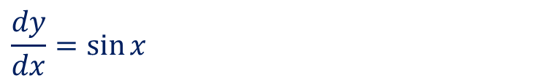



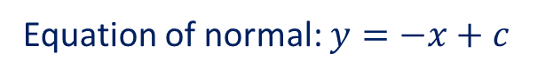

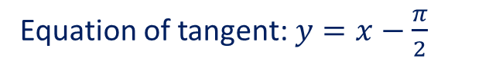
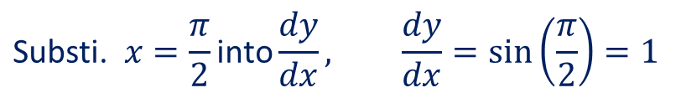

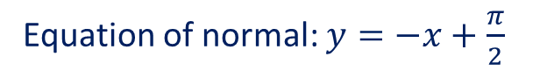
Guided Practice (Exercise 5A Example 5)
Determine the equations of the tangent and normal to the graph of $y=−\cos{x}$ at point $\left(\frac{π}{2},0\right)$
$$\frac{dy}{dx}=\sin{x}$$
$$\text{Substi}\text{. }x=\frac{π}{2}\text{into}\frac{dy}{dx}, \frac{dy}{dx}=\sin\left(\frac{π}{2}\right)=1$$
Gradient of normal is perpendicular to gradient of tangent, $=−1$
Gradient of tangent at $\left(\frac{π}{2}, 0\right)$ is $1$
Equation of normal: $y=−x+c$
Equation of tangent: $y=x+c$
subst $\left(\frac{π}{2}, 0\right)$ into $y, 0=−\frac{π}{2}+c$
subst $\left(\frac{π}{2}, 0\right)$ into $y, 0=\frac{π}{2}+c$
$$c=\frac{π}{2}$$
$$c=−\frac{π}{2}$$
Equation of normal: $y=−x+\frac{π}{2}$
Equation of tangent: $y=x−\frac{π}{2}$

Slide 17
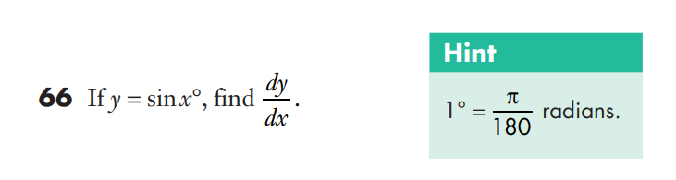
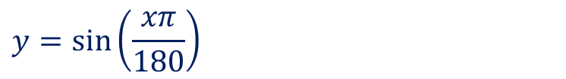
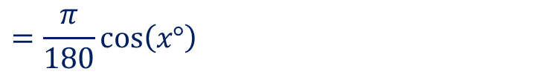
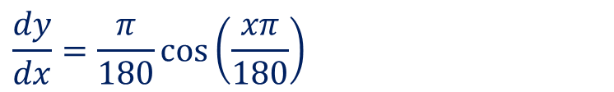
Guided Practice
$$y=\sin\left(\frac{xπ}{180}\right)$$
$$\frac{dy}{dx}=\frac{π}{180}\cos\left(\frac{xπ}{180}\right)$$
$$=\frac{π}{180}\cos\left(x°\right)$$

Slide 18
Independent Practice
Complete Cambridge Ex 4I Except Q5

